Slide 1

BI Solution for Chewy, Inc.
Tatiana Brown
Colorado State University Global
MIS480: Capstone – Business Analytics and Information Systems
Dr. Orenthio Goodwin
May 15, 2022
Notes:
Hello,
I am Tatiana Brown, and this is a capstone presentation. This project discusses Business Intelligence and its applications for Chewy, Inc.

Slide 2
Overview
Chewy, Inc
Why BI?
Business Theory
Business Intelligence
Tools, Datasets, Data Cleaning, Analysis, Visualization
Advantages and Disadvantages
Conclusion
Notes:
Today we are going to talk about who Chewy is as a company and what business intelligence, also referred to as BI, can do for the organization. A proposed business theory will suggest a type of insight that can be gleaned from using BI in its business processes. Additionally, a more thorough examination is conducted of BI tools and platforms, basic and in-depth data analysis, and graphics that enable visualization of the data. I elaborate on the dataset used for the business theory, and the benefits and challenges of applying BI.

Slide 3

Who is Chewy?
E-Commerce Enterprise Retailer
Provides Pet Products and Services,
Pet Food Autoship Program
Notes:
Founded in 2011, Chewy is an online retail corporation that offers pet products, like food and toys, and pet services, like veterinary consults and pharmacy services. Chewy’s primary customer program is a subscription service called Autoship that sends customers their selected products at customer-designated intervals (biweekly, monthly, etc).
In 2017, Chewy was acquired by PetSmart in a multi-billion-dollar acquisition. With the boom of e-commerce during the recent pandemic, online retail increased by 35%. Additionally, Chewy has the potential to serve U.S. household for which over 38% of homes have dogs and 25% have cats (AVMA, 2018). In the past decade, there has also been a steady growth in pet-related spending and ownership, and e-commerce.
I chose Chewy because, although my dog passed away last week, Chewy has been an amazing company to patron, and I wish nothing but success for them. Chewy is exemplary of a company that produces an immense amount of data for which business intelligence can enhance and guide data-driven decisions for the betterment of both the customer and the organization.

Slide 4
Why Does Chewy Need BI?
Online Model Conducive to Real-time Data Analysis
Autoship Program Generates Generous Portion of Revenue
Post-COVID, Quarterly Earnings Showed Losses
BI Supports Improved Decision Making
Notes:
Chewy, being an online pet product retailer and service provider, already collects and manages volumes of data that is produced in real-time. As with many subscription services, Chewy’s Autoship is a large contributor to its revenue. Chewy’s operations have been greatly impacted by the past two years’ rising supply costs and supply chain disruptions (Rains, 2022). Chewy’s 2021 Q4 showed a net loss of $63.6 million, and attributed hiking costs as a large factor; however, the company is still projected to see moderate growth in the near-future earnings reports (Rains, 2022).
This is where effective BI can be impactful on revenue outcomes. We will see towards the end of the presentation many of the advantages BI offers to enterprises.

Slide 5

Business Theory
Enhanced BI Contribute to Improved Quarterly Earnings
Web Behavior Predicts Autoship Subscription
Better Market Differentiation and Conversion
Reduce Subscription Churn
This Photo by Unknown Author is licensed under CC BY
Notes:
As I come to the conclusion of the management information systems and business analytics program at Colorado State University, I have a better understanding of how the knowledge gained from analyzing data improves business processes and outlook. Business intelligence applications can be realized to improve Chewy’s earnings as well as to adapt company aspects, such as marketing and sales, to insights gained. It is my theory that Chewy can better differentiate potential Autoship customers through web analytics of customer behaviors. In turn, this can enable targeted marketing and take actions to reduce the churn of active subscriptions.

Slide 6
BI Tools
APPLIED PROGRAMS
Kaggle
Excel
R Studio
ALTERNATIVES
SQL
Python or SAS
Tableau or Power BI
Notes:
There are many BI tools available today. Free, open-source tools, low-cost tools, and high-cost, enterprise-directed cloud-based tools are offered in today’s market.
For this capstone, a dataset was acquired from Kaggle, a Google subsidiary. Kaggle is a repository of various free datasets that can be used for model-building and data exploration (Kaggle, n.d.). As a beginner, I found using Excel was the most straightforward way to clean the data before uploading it into R Studio for analysis and visualizations.
However, there are many alternatives for BI tools. SQL is a programming language used with relational databases that are sometimes found in corporations. SQL can be used to extract a sample dataset for data analysis. Both Python and SAS are programming languages used in data analysis to gain intelligence of real-time data. Once the analysis has been performed, BI platforms like Tableau or Power BI can transform the results into graphs and dashboards. Data visualization is a great way to take in information about massive amounts of data while allowing for trend and pattern identification (splashBI, 2022).

Slide 7

Pet Food Dataset
Pet Food Customer Orders
From Kaggle.com
49,042 Observations, 36 Fields
Dependent Variable
Active Pet Subscription (Y/N)
Notes:
The dataset retrieved from Kaggle contains 36 columns and 49,092 rows of anonymized data. The columns contained variables related to customer order activity, pet demographics, and web analytics (Raina, Pet Food Customer Orders, 2021). In concordance with the business theory that web analytics can identify potential subscribers, this dataset allows for relevant model building.

Slide 8
Data Cleaning and Sampling
Excel
Irrelevant Fields Removed
From 36 to 20 variables
Sample Size Calculated at 0.95 Confidence Level
Sample Size: 384 Observations
Remove Select Observations with NULL Values
Rows Assigned Random Numbers
1-384 extracted
Notes:
Before data manipulation can begin, the data has to be clean. That is, data that is incorrect, missing, irrelevant, or redundant is removed before use (Elgabry, 2019). Data that was missing from the variables for customer_id, pet_id, and pet_has_an_active_subscription were removed. Duplicate customer_id entries were present, but not removed because it is likely that some customers have more than one pet.
Once the data was cleaned, each row was assigned a random number. Calculations determined that the appropriate sample size for this dataset was a population of 384 observations (Qualtrics, 2022). Observations randomly numbered 1-384 were extracted and used in R Studio for model building.

Slide 9

Analysis-Stats
65% of Sample -> Active Subscription
Mean Total_web_visits: 10 ; Range: 0 – 70
Mean Total_min_website: 428 (~ 7 hrs) ; Range: 0 – 6,813
Total_minutes_on website_since_last_order Mean: 81 ; Median: 2 ;
Raneg: 0 – 2,928
Customer_support_ticket_category:
Highest: Account 52 , Health 16
Lowest: Website 1 , General 2 , Proactive 2
Notes:
In R Studio, a basic statistical summary was generated. From the dataset, it was shown that nearly 1/3 of sampled customers had an active pet subscriptions. Since the focus is on web behaviors, the following variables were extracted: count of total web visits, count of total minutes spent on web, total minutes on website since last order, and the ticket category for contacting customer support.
The average number of total visits to the website was 10. The range indicated that the highest number was 70 visits which is likely an outlier value. Similarly, the average total number of minutes on the website roughly totaled to 7 hours; however, the maximum a customer spent was almost 114 hours or 6,813 minutes. Between orders, customers average 81 total minutes on the website and the median, or middle, value was 2 minutes. Such a variation between the mean and median indicates a significant skew; in this case, it is a right-skew that can be visualized during plotting. Customer_support_ticket_category is the categorical variable that indicated the reason a customer contacted customer service. The most frequent reason for customer support contact was related to customers’ accounts, and the second was health-related questions. The least present reasons for contact in the sample were the website, general questions, and proactive contact.
If Chewy wanted to extend BI beyond customer subscriptions, it could look into why customer contacts for the website are so low. Is it a positive sign or is there something being overlooked? Relationships between the other variables can provide insight.

Slide 10
Analysis Outcomes
Basic Summary Statistics
Histograms & Bar Charts
CART
Notes:
The outcome of the basic summary statistics showed how the data is distributed. Using data visualization tools in R Studio, histograms and bar charts were built to illustrate distributions and frequencies for each variable. I go into a detailed example of each in the next slide. Lastly, the dataset is used to build a predictive model. This model shows the relationship of the dependent variable, pet_has_an_active_subscription, with the other given variables. Additionally, it enables statistical predictions of subscription likelihood given the independent variable. The subscription variable is binary and many of the independent variables were categorical or continuous, so I felt a classification and regression tree (CART) would be the most straightforward analysis model.

Slide 11
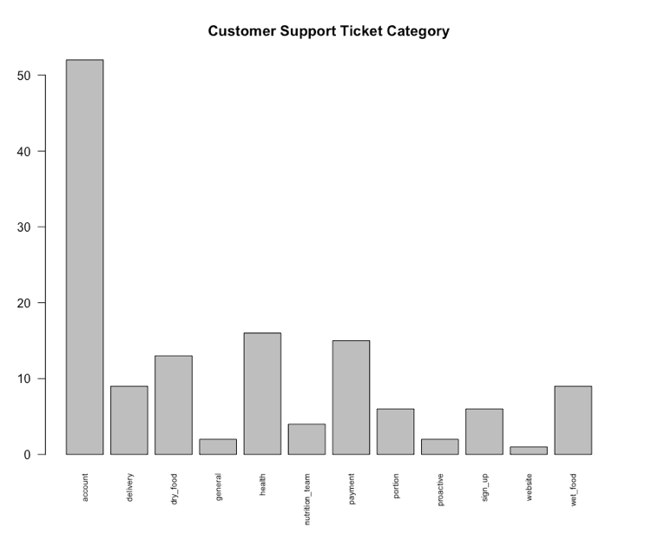
Data Visualization
Notes:
Here are two examples of visualizations produced using R for this analysis. On the left is a histogram representing continuous data grouped into bins. This particular variable was previously mentioned for its outlier of 70 total number of web sessions by a customer. Depending on the type of analysis being done and data cleaning guidelines, observations with outliers like this may be removed before analysis. Otherwise, from this visualization, we can readily identify it is more common for there to be fewer than 20 visits per customer; more specifically, customers often have less than 5 total visits.
The graph on the right is a bar chart that visualizes each category of customer support tickets. Visualization offers quick identification that customer support is most frequently contacted over account questions or concerns. It can also be seen that for the sample population, it is rare for a customer to contact support for website issues.

Slide 12
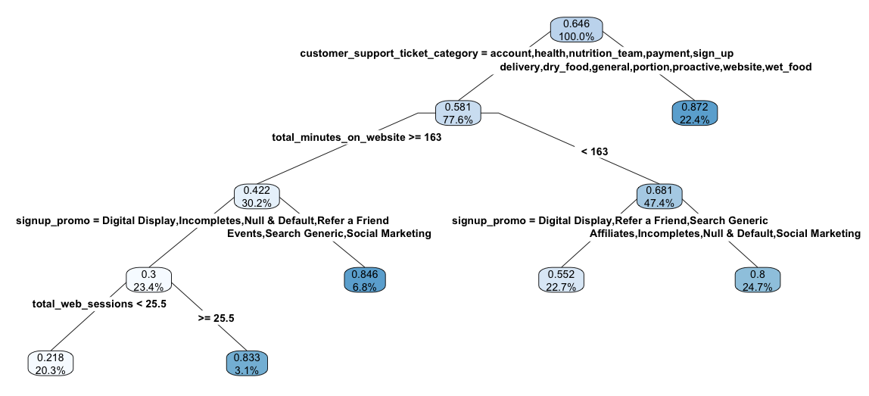
Classification & Regression Tree
Notes:
The CART approach to regression is well-suited for the sample dataset’s complex predictor variables (Zach, 2020). CART is a decision tree used in data analytics for predictive modeling. Its structure includes root nodes, internal nodes, and leaf nodes. Internal nodes are the primary decision-makers, and leaf nodes hold the final decision (Dutta, 2021).
In this model, the logical pet subscription variable was the response variable since we want to know what variables indicate the probability that a customer will have an active subscription for their pet. For this data analysis scenario, the tree was pruned to four response variables (customer support category, total minutes on website, signup promo, and the total number of web visits) that were used to build the model with the notion that pet subscriptions can be understood from customer interactions with the website.

Slide 13
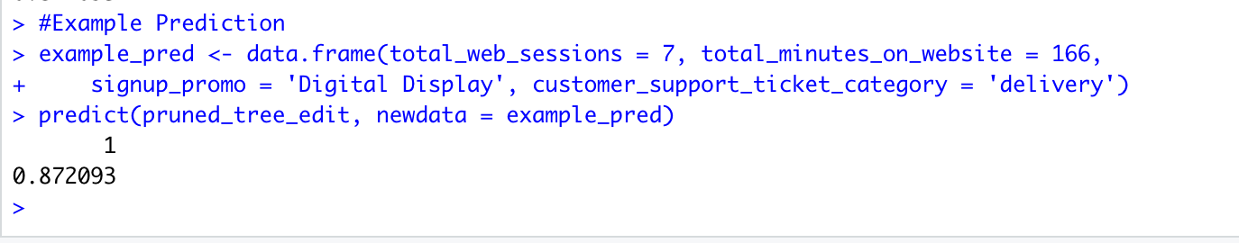
Analysis- Predictions
Notes:
Here we have created a prediction output for an example customer. In the R script, we see that the customer has had 7 total web sessions, has spent 166 minutes total on the website, used the sign-up promotion “Digital Display”, and contacted customer support for delivery questions. The decision tree can be used with these factors to predict the likelihood that the customer has an active pet subscription. Because we start at the root node at the top, we take the right branch for customer_support_ticket_category for ”delivery”.
Regardless of the other descriptors for the example customer, this branch ends as a leaf node. The values seen in the node indicate that there is an 87.2 percent probability of subscription, and this branch contains 22.4 percent of the observations for that variable. In other words, 22.4 percent of customers contacted customer support for delivery, dry_food, general, portion, proactive, website, or wet food tickets.
This same tree can be used for predictions with other values for each variable, too.

Slide 14

Benefits of BI
Fast, Accurate Reporting
Operational Efficiency
Data Quality Improvement
Increased Revenue
Decreased Costs
Enhanced Decision-Making
(BI-Survey, 2021)
This Photo by Unknown Author is licensed under CC BY-SA-NC
Notes:
So far, we know that business intelligence is great for an organization---especially Chewy. But why is it so great?
Because business intelligence is multi-faceted, an organization is affected enterprise-wide. Processed data can be fed into dashboards for up-to-date changes through BI platforms. This allows reports to be generated quickly, and because much of this process is automated, it tends to be more accurate than manual alternatives (BI-Survey, 2021). Moreover, the quality of data in these reports is improved because it must go through the scrubbing phase before being introduced to the BI system. In a snowball effect, these benefits lead to enhanced decision-making. Data-driven decisions stem from accurate and current information sourced from quality data.
The next three advantages are closely related. Business intelligence improves operational efficiency which in turn can simultaneously increase revenue and decrease costs. As cliché as it is, BI enables the organization to become better, working like a “well-oiled machine”—all the different parts functioning smoothly together.
But, if implementing a business intelligence system is so beneficial and significant, why is the failure rate between 70 and 80 percent (Rands, 2017)?
Because achieving all the benefits that BI offers is much easier said than done.

Slide 15

Challenges
Upfront Costs and ROI
Poor Data Quality
Lack of BI Strategy
Poor Adoption
(Durcevic, 2019)
Notes:
Introducing and/or implementing a business intelligence system is challenging. Although reduced costs and increased revenue is considered a benefit of BI, it isn’t a given. The upfront costs of this can exceed organizational resources, and poor execution of integration diminishes the return on investment. Some organizations cannot afford the system that best fits their needs; some get lost in the options and have a difficult time introspecting into what are the business’s BI needs. This ties into the lack of BI strategy. When implementing a BI system, there are planning and analysis phases where the business’s BI needs are identified and aligned with the BI tool. However organizational needs can change or be in dispute between stakeholders. This can convolute the process of pairing the system with the business. This challenge can be avoided or reduced by dedicating ample time to the two aforementioned phases.
In the age of Big Data, acquiring data is much easier than acquiring and identifying quality data. Sometimes, important data gets lost in the terabytes of data being collected, and there are occasions when data quality management within the organization is weak (Durcevic, 2019). This can negatively impact BI output.
Lastly, user adoption is a common challenge to business intelligence implementation. A company can pour money into a premium BI system, but if the users don’t use it or if they aren’t using it correctly, then the system was all for naught. Strategic change management can guide users into system acceptance.

Slide 16

Conclusion
Business Intelligence boosts organizational insight
BI aids understanding of variable relationships
Chewy, Inc. benefit from using BI for customer subscriptions
Enables Predictive Outcomes
Advantages and Disadvantages
Notes:
America is in love with its pets, and it is in love with the convenience of e-commerce. Chewy found itself successfully niching that market. Chewy’s quarterly losses are evidence of some disconnect with its business intelligence or growth outlook. By evaluating a hypothetical dataset, an understanding can be gained of potential correlations between certain variables and the likelihood to be an Autoship member. This effect is enhanced and translated using data visualizations from platforms, like R Studio. Chewy is a large enterprise that requires several levels of information systems and databases which is challenging for effective business intelligence implementation. However, by focusing on understanding its customers and their needs, Chewy can improve its outlook for future quarters.
Using business analysis tools, insight can be extracted from an amalgamation of data. Business intelligence tools offer a wealth of advantages even if some are more difficult to achieve. In this analysis, a pet food dataset was selected and used to examine a theory that variables from the dataset can determine the probability of a customer being an active subscriber. This can, in turn, drive marketing efforts towards improved conversions. The data set was sampled and trimmed down before being used to model a classification and regression tree in R Studio. Variables applied to the model were web-related: customer support ticket categories, signup promotion types, total minutes on website, and total web sessions. Once modeled, the decision tree can be used to make predictions. This enables the company to improve its decision-making process around the knowledge gained.
Business intelligence comes with many benefits, but not all are guaranteed. Like with any new system introduction, the implementation must be intentional and strategic. Otherwise, the BI system will be felled to the challenges of integration. Proper planning and requirement analysis can minimize or eliminate many of the challenges and allow companies, like Chewy, to fully recognize the immense advantages that business intelligence offers.
Thank you.

Slide 17
References
AVMA. (2018). U.S. pet ownership statistics. American Veterinary Medical Associatio.: https://www.avma.org/resources-tools/reports-statistics/us-pet-ownership-statistics
BI-Survey. (2021, February 08). The Benefits of Business Intelligence... Why Do Organizations Need BI? BI-Survey. https://bi-survey.com/benefits-business-intelligence
Durcevic, S. (2019, May 22). Common Business Intelligence Challenges Facing Entrepreneurs. DataPine. https://www.datapine.com/blog/business-intelligence-challenges/
Dutta, B. (2021, July 27). A Classification and Regression Tree (CART) Algorithm. Analytics Steps. https://www.analyticssteps.com/blogs/classification-and-regression-tree-cart-algorithm
Elgabry, O. (2019, February 28). The Ultimate Guide to Data Cleaning. Towards Data Science. https://towardsdatascience.com/the-ultimate-guide-to-data-cleaning-3969843991d4
Kaggle. (n.d.). How to Use Kaggle: Datasets. Kaggle. https://www.kaggle.com/docs/datasets
Notes:
AVMA. (2018). U.S. pet ownership statistics. Retrieved from American Veterinary Medical Association: https://www.avma.org/resources-tools/reports-statistics/us-pet-ownership-statistics
BI-Survey. (2021, February 08). The Benefits of Business Intelligence... Why Do Organizations Need BI? Retrieved from BI-Survey: https://bi-survey.com/benefits-business-intelligence
Durcevic, S. (2019, May 22). Common Business Intelligence Challenges Facing Entrepreneurs. Retrieved from DataPine: https://www.datapine.com/blog/business-intelligence-challenges/
Dutta, B. (2021, July 27). A Classification and Regression Tree (CART) Algorithm. Retrieved from Analytics Steps: https://www.analyticssteps.com/blogs/classification-and-regression-tree-cart-algorithm
Elgabry, O. (2019, February 28). The Ultimate Guide to Data Cleaning. Retrieved from Towards Data Science: https://towardsdatascience.com/the-ultimate-guide-to-data-cleaning-3969843991d4
Kaggle. (n.d.). How to Use Kaggle: Datasets. Retrieved from Kaggle: https://www.kaggle.com/docs/datasets

Slide 18
References
Qualtrics. (2022, April 1). Determining sample size: how to make sure you get the correct sample size. Qualtrics: https://www.qualtrics.com/uk/experience-management/research/determine-sample-size/
Raina, J. (2021). Pet Food Customer Orders. Kaggle. https://www.kaggle.com/code/jahangirraina/pet-food-customer-orders-data-insights
Rains, B. (2022, April 13). Bear of the Day: Chewy, Inc. (CHWY). Nasdaq. https://www.nasdaq.com/articles/bear-of-the-day%3A-chewy-inc.-chwy-1
Rands, K. (2017, September 25). 4 reasons most companies fail at business intelligence. CIO. https://www.cio.com/article/230614/4-reasons-most-companies-fail-at-business-intelligence.html#:~:text=Gartner%20says%20that%20anywhere%20from,that%20failure%20rate%20is%20astounding.
splashBI. (2022, April 21). Importance, Purpose, And Benefit Of Data Visualization Tools! splashBI. https://splashbi.com/importance-purpose-benefit-of-data-visualization-tools/#:~:text=Data%20visualization%20allows%20business%20users,turn%2C%20drives%20the%20business%20ahead.
Notes:
Qualtrics. (2022, April 1). Determining sample size: how to make sure you get the correct sample size. Qualtrics: https://www.qualtrics.com/uk/experience-management/research/determine-sample-size/
Raina, J. (2021). Pet Food Customer Orders. Kaggle. https://www.kaggle.com/code/jahangirraina/pet-food-customer-orders-data-insights
Rains, B. (2022, April 13). Bear of the Day: Chewy, Inc. (CHWY). Nasdaq. https://www.nasdaq.com/articles/bear-of-the-day%3A-chewy-inc.-chwy-1
Rands, K. (2017, September 25). 4 reasons most companies fail at business intelligence. CIO. https://www.cio.com/article/230614/4-reasons-most-companies-fail-at-business-intelligence.html#:~:text=Gartner%20says%20that%20anywhere%20from,that%20failure%20rate%20is%20astounding.
splashBI. (2022, April 21). Importance, Purpose, And Benefit Of Data Visualization Tools! splashBI. https://splashbi.com/importance-purpose-benefit-of-data-visualization-tools/#:~:text=Data%20visualization%20allows%20business%20users,turn%2C%20drives%20the%20business%20ahead.

